Slide 1
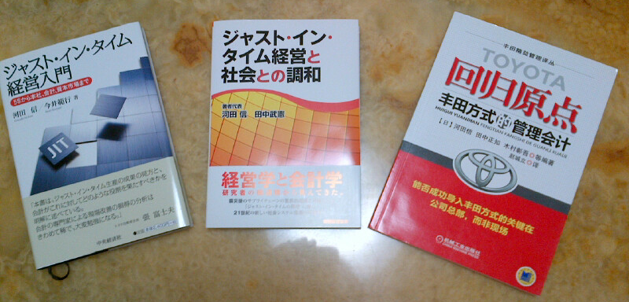
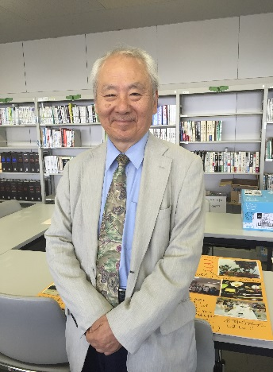
Dr. Makoto Kawada
Professor Emeritus, Meijo University
1942 Born in Beijing, China
1964 Graduated from Law school, Keio University
Entered Meidensha Corporation
1972 Entered Teijin Seiki Co. Ltd.
General Manager, Systems Department,
Corporate Planning Department, Research &
Development
Promotion Department
1997 Ph.D. in Economics from Tohoku University
1999 Professor, Faculty of Business, Meijo
University
2007 Dean, Graduate School of Business, Meijo
University
2012 Professor Emeritus, Meijo University
2015 Visiting Professor, School of Modern
Management Sugiyama Jogakuen Univ. (Present)
2015 Leader, ESD21 “Society for the Study of
Companywide Optimum JIT Management (Present)
Major in: Production Systems, Management Accounting,
Marketing Theory, Small & Medium Enterprise Management
Research: How to enhance the Possibility of Successful Introduction of TPS Overseas
Achievements: Strategic Management Accounting Why and How, Management Accounting, Aug.
（Certificate Appreciation Award, 1993-1994）
1994 Relevance Regained H.T. Johnson
(Translation into Japanese with Prof. Atsuo Tsuji)
1996 Product Management Accounting, Chuo-Keizai-sha
2002 Profit Beyond Measure, H.T. Johnson & A.Bröms(translation as chief editor)
2004 Toyota System and Management Accounting, Chuo-Keizai-sha
2009 Toyota Way Re-Industrializing Management Accounting for New Age,
Chuo-Keizai-sha (in Japanese, co-authored, chief editor)
2013 Harmonization of Just In Time and Society, Tax & Accounting
Association, in Japanese, co-authored, as chief editor)

Slide 2
Outline of JIT Management
Many people know the term of JIT (Just in Time). But they , including Japanese managers, tend to misunderstand the implication. Dr. Kawada explains JIT management is the way to realize the shifting of mindset of a company as a whole from the “operation- focused” to the “lead-time focused” in a shortest possible period.
As is known, Toyota is making high profit at present, however profit is not the “purpose” of Toyota, but is only the “result” of creating flow based on “respect-for-humanity” vision. “Just-In-Time production” of Toyota emphasizes to produce only what is needed, when it is needed, and only by the quantity required from customer, the result of which is the ever shorter lead time that increases cash flows and enables quick responses to the changing environment in the global economy.
But, these three suppositions for “lean” seem to be difficult to accept for those who regards ” full operation of resources as the most important in “make-to-stock, mass production”. But, JIT regards “the faster flow of material” is the most important for “make-to order, limited production”. Therefore, “full operation at the non-bottle neck” process is the biggest Muda, or wastes of money for Toyota. In order to encourage the factory to shift quickly to such “creating-Flow” thinking, Dr. Kawada recommends to reorganize the financial KPI at headquarters, which is technically easy if only CEO & CFO and/or headquarters’ accountants could be free form the conventional “short-term profit-alone” mindset, and give equal importance to the “Quality of the Balance Sheets” or SCCC( Supply Change Cash Conversion Cycle) and other “creating-flow” related financial KPIs.
Dr. Kawada is leading a major research project team in ESD21, or Economical, Sustainable Development 21 centuries. The mission of his team is to help especially SMEs in Japan and overseas successfully introduce “JIT management” based on the smarter triangle relationship between Bemba , Headquarters and IoT.

